Slide 1
Arrays
5 Sept 2013
Notes:
Guidewire training materials contain Guidewire proprietary information that is subject to confidentiality and non-disclosure agreements. You agree to use the information in this manual solely for the purpose of training to implement Guidewire software solutions. You also agree not to disclose the information in this manual to third parties or copy this manual without prior written consent from Guidewire. Guidewire training may be given only by Guidewire employees or certified Guidewire partners under the appropriate agreement with Guidewire.

Slide 2
Lesson objectives
By the end of this lesson, you should be able to:
Determine the number of elements in an array
Loop through each element in an array
Add elements to (and remove elements from) an array
Determine if any elements with a given criterion exists in an array
Retrieve elements in an array that match a given criterion
This lesson uses the notes section for additional explanation and information. To view the notes in PowerPoint, choose View→Normal or View→Notes Page. If you choose to print the notes for the lesson, be sure to select “Print hidden slides.”

Slide 3
Lesson outline
Arrays
Array methods that require conditions

Slide 4
Arrays
In Guidewire, there are two types of arrays
Data model array
For a given row in the database, it identifies the rows in some other database table that are related to that row
Declared in eti/etx files
Example: ABContact.AllAddresses
Gosu arrays
A set of values that share the same datatype and have been grouped into a single structure
Declared using syntax: var arrayName = datatype[]
Example: var tempAddresses = Address[]
This lesson focuses on data model arrays because this is the type of array used most often in configuration work

Slide 5
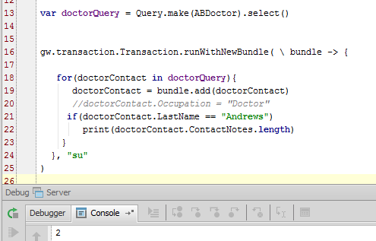
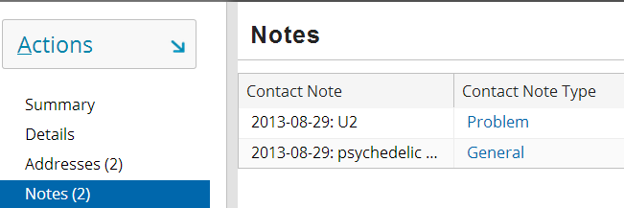
Array length
Every array has a length property that identifies its size
Syntax: array.length

Slide 6
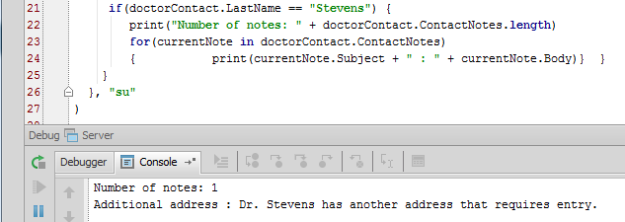
Arrays and loops
Gosu for loops are used to iterate through objects in arrays
Syntax: for (currentObject in objectSet) { // statements that process currentObject }
Notes:
A Gosu for loop can be used to process any type of object set, including arrays, strings, Java collections, and Java iterators. In practice, the majority of for loops are used for processing arrays.
Most scripting languages have for loops in which the programmer must manually reference each element of the array and advance some pointer to the next element of the array. This is typically done using a counter variable, a condition, and a counter variable incrementer, such as:
for (x=0, x<anArray.length, x++) {
// statements referencing anArray[x]
}
The counter variable is x, the manual reference to each element is anArray[x], and the manual advancing to the next element in the array is accomplished by x++.
Gosu for loops are typically easier to code because the reference to each element in the array is managed inherently by the for loop. The programmer needs to specify a name for the current object (the currentObject placeholder). This name then automatically references the current object in the array, and the for loop inherently advances to the next object in the array when the end of the loop is reached.
Thus, translating the typical loop to a Gosu loop (as the slide shows) is accomplished as follows:
for (currentObject in anArray) {
// statements referencing currentObject
}
Gosu also supports these types of loops, but in practice they are usually not needed:
While
Do...While
For more information, refer to the Gosu Reference Guide

Slide 7
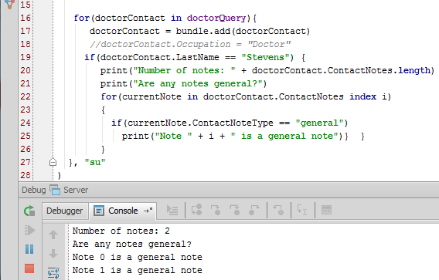
Adding index variable to for loops
Syntax: for (currentObject in objectSet index indexVar)

Slide 8
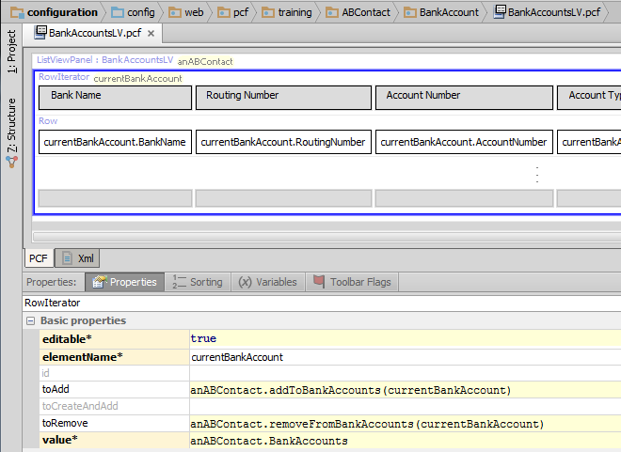
Adding/removing objects in data model array
Notes:
The addTo...() and removeFrom...() methods work only for arrays that are declared in the data model (in an eti/etx file).
The example above is from the BankAccountsLV row iterator. The list view has a toolbar with Edit buttons. Clicking the Add button creates a new bank account object which can be referred to as currentBankAccount. The toAdd property specifies the Gosu to add the object to the BankAccounts array on anABContact.
The addTo and removeFrom methods can be used anywhere Gosu can be used. If they are used in the Gosu Tester, however, they will have no effect unless you manually commit the bundle associated with the parent object.

Slide 9
Lesson outline
Arrays
Array methods that require conditions

Slide 10
Array methods that require logic
Arrays have methods that you can use to:
Get information about the array
Get members of the array that match a given condition
These methods require an argument that must be an expression of a condition, such as:
hasMatch( condition )
Returns true if any row in the array matches the condition
where( condition )
Returns all rows that match the condition
firstWhere( condition )
Returns the first row that matches the condition
For these methods, the argument must be a Gosu structure known as a block

Slide 11
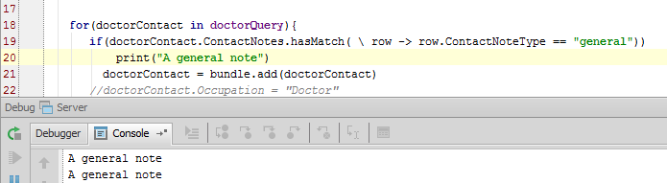
Blocks that define conditions
A block is an expression of logic that can be passed to a method as an argument
For array methods that require conditions, the block consists of the following four parts:
A slash (\), which identifies that the following is a block
An arbitrary name representing each element of the array
An arrow (→), which identifies the start of the condition
A condition that typically references the arbitrary name
4
1
2
3
Notes:
Blocks are used in many situations where a method requires an expression as an input parameter, such as:
Arrays
hasMatch() - used to determine if any element in an array matches a given condition
firstWhere() - used to retrieve the first element in an array that matches a given condition
where() - used to generate a target array that consists of all the members of a source array that match a given condition
These methods are discussed in greater detail in the next set of slides.
Queries
or() - used by queries objects to join multiple conditions together with OR logic
orderBy() - used by result set objects to specify logic for how to order the results in the set (in ascending order)
orderByDescending() - used by result set objects to specify logic for how to order the results in the set (in descending order)
These methods are discussed in greater detail in the "Queries" lesson of this course
Database transactions and bundles
runwithNewBundle() - used to create a bundle of run-time objects and then commit data in those objects to the database
This method is discussed in greater detail in the Application Integration courses

Slide 12
Block syntax (for array condition methods)
Syntax: ( \ elementName -> conditionToMatch ))
-> appears in Studio as an arrow (→)
Notes:
In the example above, each element of the array has a note that is marked as “General”. Therefore, hasMatch() returns true and the print statement on line 20 is executed, resulting in a print statement for each element in the array.

Slide 13
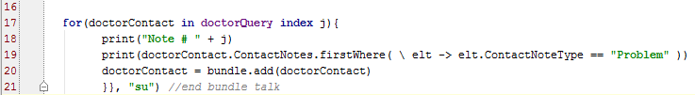

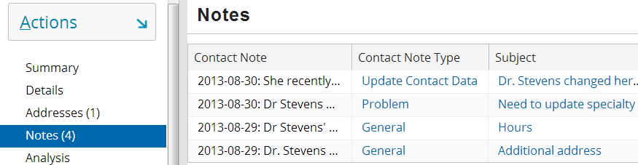
Finding first element that meets a condition
firstWhere() returns the first element of the array that meets the given condition
Syntax: array.firstWhere( \ name -> conditionToMatch )
Notes:
In the example above, the second element of the array with a Contact Note Type of “Problem” is returned.

Slide 14
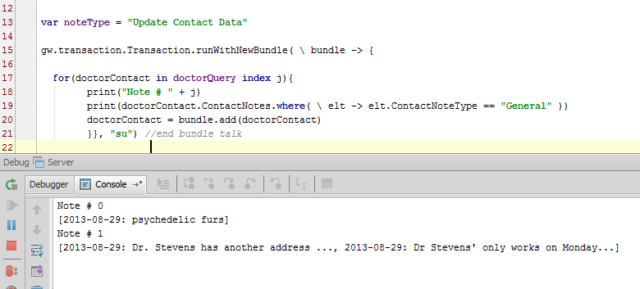
Finding all elements that meets a condition
where() returns an array of all elements of the source array that meet the given condition
Syntax: array.where( \ name -> conditionToMatch )
Notes:
In the example above, all the elements in the ContactNotes array are printed for each ABDoctor the query returns.

Slide 15
Lesson objectives review
You should now be able to:
Determine the number of elements in an array
Loop through each element in an array
Add elements to (and remove elements from) an array
Determine if any elements with a given criterion exists in an array
Retrieve elements in an array that match a given criterion

Slide 16
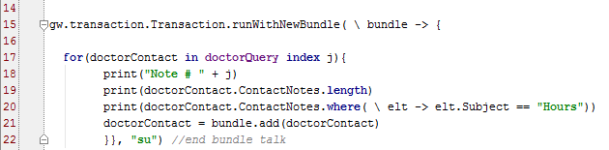
Review questions
1. The following screen shows several Contact Notes exist for an ABDoctor. What will line 19 return based on the information in the first screen (HINT: see the highlighted item)?
2. There are two contacts of type ABDoctor in the database. How many times will line 17 be executed?
3. What output do you expect after line 20 executes for the second time (HINT: the first screenshot should help you deduce the output)
Notes:
Line 19 asks for the length of the ContactNotes array. The first screen comes from the second database record, which contains four notes. The length of the array is 4.
Because there are two doctor contacts in the database, the query returns two doctors. Thus Line 17 will execute two times.
Line 20 is an instruction to print the Notes contents for the Contact Note with the Subject titled, “Hours”.

Slide 17
Notices
Copyright © 2001-2013 Guidewire Software, Inc. All rights reserved. Guidewire, Guidewire Software, Guidewire ClaimCenter, Guidewire PolicyCenter, Guidewire BillingCenter, Guidewire Reinsurance Management, Guidewire ContactManager, Guidewire Vendor Data Management, Guidewire Client Data Management, Guidewire Rating Management, Guidewire InsuranceSuite, Guidewire ContactCenter, Guidewire Studio, Guidewire Product Designer, Guidewire Live, Guidewire DataHub, Guidewire InfoCenter, Guidewire Standard Reporting, Guidewire ExampleCenter, Gosu, Deliver Insurance Your Way, and the Guidewire logo are trademarks, service marks, or registered trademarks of Guidewire Software, Inc. in the United States and/or other countries.
Guidewire products are protected by one or more United States patents.

